Slide 1













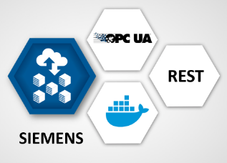

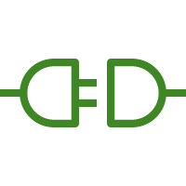

AWS Cloud
Region
AWS IoT Core
AWS IoT SiteWise
Availability Zone 1
Availability Zone 2
VPC
AWS Lambda
Public subnet
Classic
Load Balancer
Public subnet
Amazon S3
NAT gateway
NAT gateway
EC2 Instance
EC2 Instance
AWS ECS
AWS IoT Greengrass
AWS IoT Greengrass
OPC UA
Auto Scaling Group
OPC UA
AWS IAM
Softing edgeConnector Siemens
(Simulation Mode)
AWS IoT SiteWise Connector
Softing edgeConnector Siemens
(Simulation Mode)
AWS IoT SiteWise Connector
AWS CloudFormation

